Slide 1
Gut-Heal for Fresh Cow Health
Optimizing Cow Health Through Nutrition

Slide 2
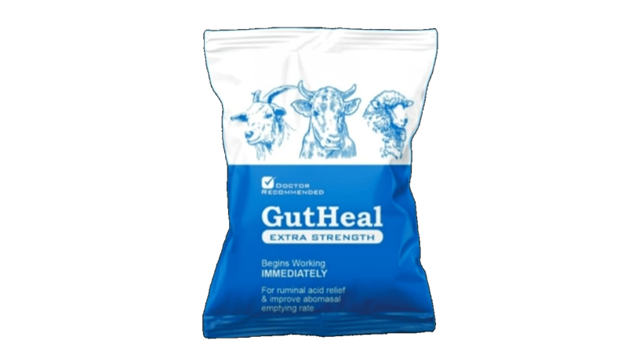
Overview of Health Issues in Fresh Cows
1. Milk fever (hypocalcemia)
2. Retained placenta
3. Metritis
4. Mastitis
5. Displaced abomasum
6. Ketosis
7. Poor milk letdown
8. Lameness/injury

Slide 3
How Gut-Heal Can Help
1. Rumen buffers & calcareous marine algae:
- Modulate pH
- Enhance calcium absorption
2. Essential oils & saponins:
- Shift microbiome
- Anti-inflammatory
3. Enzymes & algae:
- Improve digestion
- Optimize energy

Slide 4
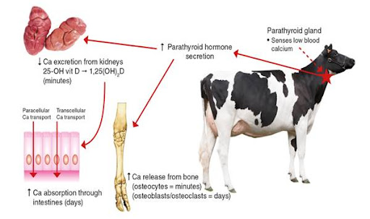
Milk Fever
Algae provide bioavailable calcium
Buffers optimize rumen pH for absorption
Prevent hypocalcemia and paresis

Slide 5
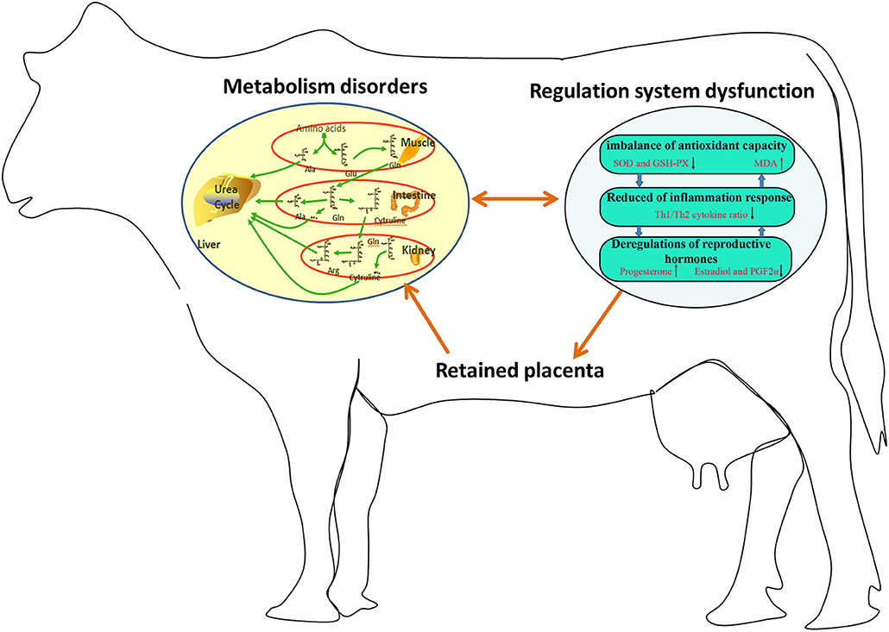
Retained Placenta
Saponins: Immune modulation
Pungent substances: Uterine circulation
Oils: Anti-infective properties

Slide 6
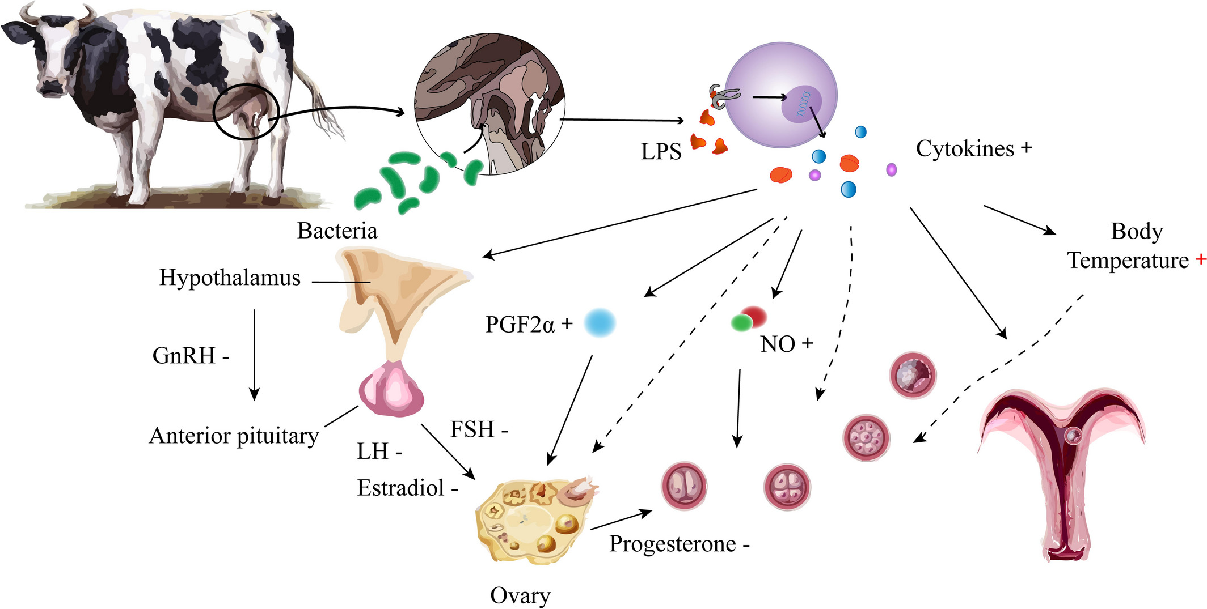
Mastitis
Saponins: Enhance immunity
Oils: Anti-pathogenic activity
Prevent intramammary infection

Slide 7
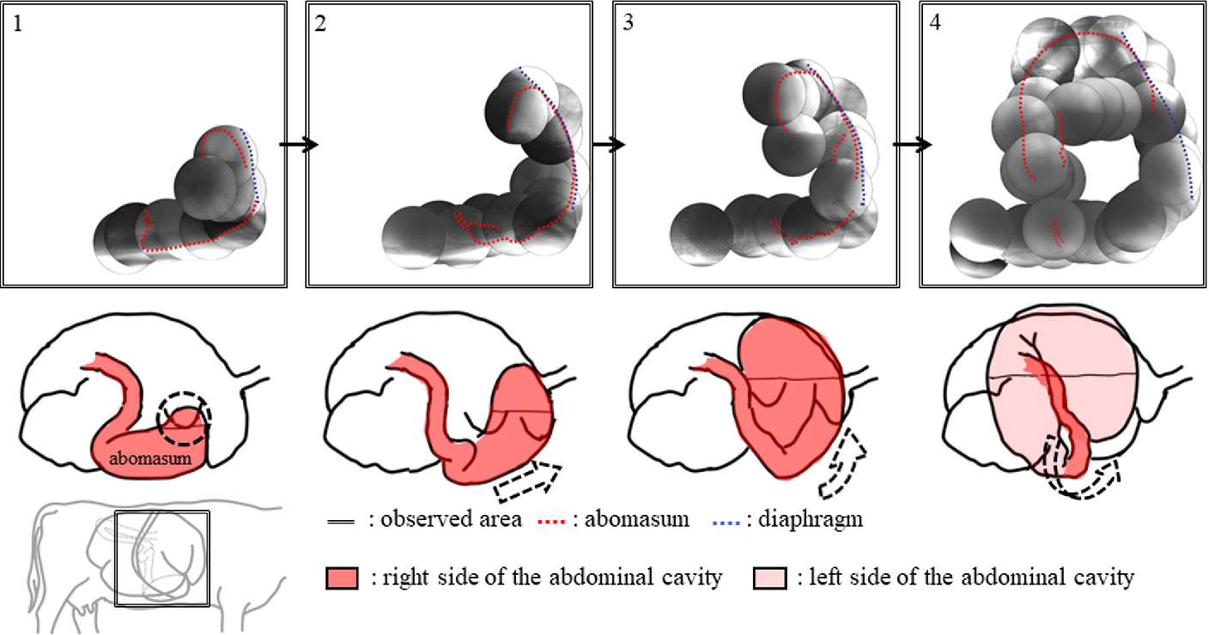
Displaced Abomasum
Oils & enzymes control gas production
Stable rumen pH prevents twisting

Slide 8
Ketosis
Improve energy extraction
Shift to propionate production
Avoid excessive fat breakdown

Slide 9
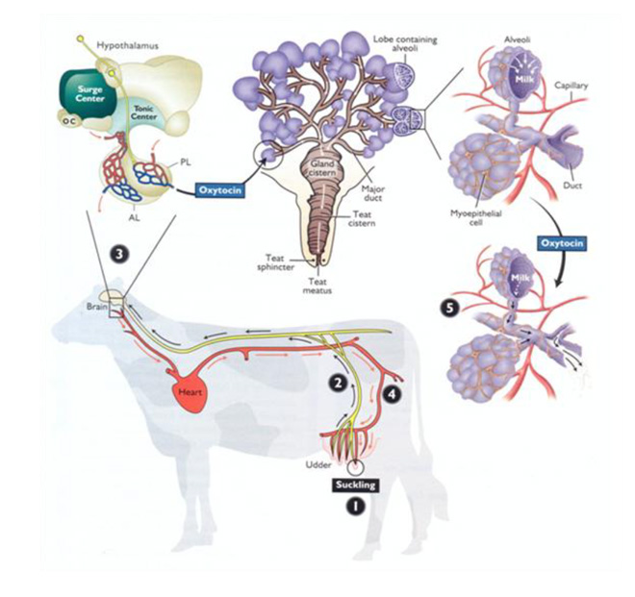
Milk Letdown
Stimulate oxytocin flow
Modulate inflammation
Optimize ejection signals

Slide 10
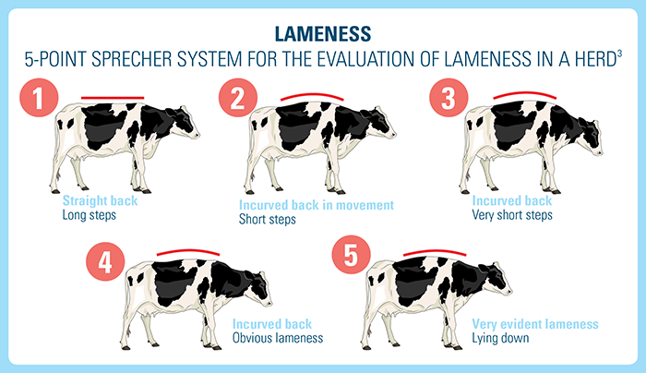
Lameness
Anti-inflammatory activity
Maintain musculoskeletal integrity
Prevent post-calving injuries

Slide 11
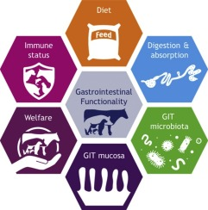
Conclusion
Gut-Heal supplements support fresh cow health through:
1. Digestion and energy optimization
2. Immune and inflammation modulation
3. Rumen microbiome regulation

